Slide 1
Nvis 3302ARD RoboCar
Physical Configuration
Dr. Ashutosh Mishra, CSED

Slide 2
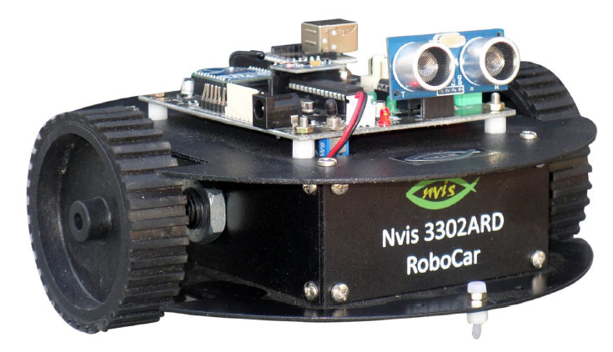
Basic Configuration model

Slide 3
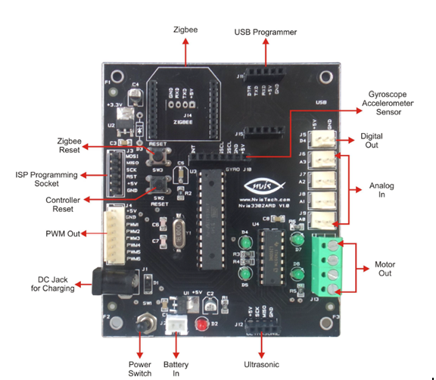
Board configuration and part name

Slide 4
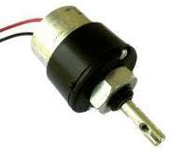
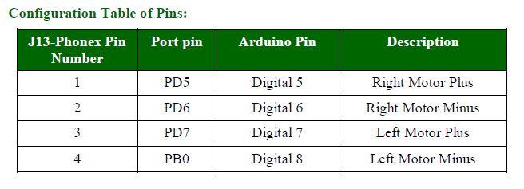
DC Motor
A motor is a machine that converts electrical energy into mechanical energy(rotation).
DC motor have only + and – leads.
By reversing the polarity, the DC motor will move in the opposite direction.

Slide 5
Basic functions of Robocar
Forward
Backward
Right Move
Left Move
Clockwise rotation
Anticlockwise rotation
Stop

Slide 6
Arduino code for Motor Movement
void setup()
{
PinMode(5,OUTPUT);
PinMode(6,OUTPUT);
PinMode(7,OUTPUT);
PinMode(8,OUTPUT);
}
void loop()
{ // Forward direction
digitialWrite(5,HIGH);
digitialWrite(6,LOW);
digitialWrite(7,LOW);
digitialWrite(8,HIGH);
}

Slide 7
//Backward
digitialWrite(5,LOW);
digitialWrite(6,HIGH);
digitialWrite(7,HIGH);
digitialWrite(8, LOW);
// Right Move
digitialWrite(5,LOW);
digitialWrite(6,LOW);
digitialWrite(7,HIGH);
digitialWrite(8, HIGH);

Slide 8
// Left
digitialWrite(5,HIGH);
digitialWrite(6,HIGH);
digitialWrite(7,LOW);
digitialWrite(8, LOW);
//Clockwise rotation
digitialWrite(5,HIGH);
digitialWrite(6,LOW);
digitialWrite(7,LOW);
digitialWrite(8, LOW);

Slide 9
// Anticlock-wise rotation
digitialWrite(5,LOW);
digitialWrite(6,LOW);
digitialWrite(7,LOW);
digitialWrite(8, HIGH);
//Stop
digitialWrite(5,LOW);
digitialWrite(6,LOW);
digitialWrite(7,LOW);
digitialWrite(8, LOW);

Slide 10
Thanks

